Slide 1

Project Overview and VR Integration Challenges
Goal: Integrate VR controls with a bowling and wall-breaking game.
Challenges: First time integrating VR, ensuring both games worked with the VR system.
By: Jesse and Monica
CITA 314
Professor: Awed

Slide 2
Video of Game
https://www.youtube.com/watch?v=dHAn-YNGWls

Slide 3
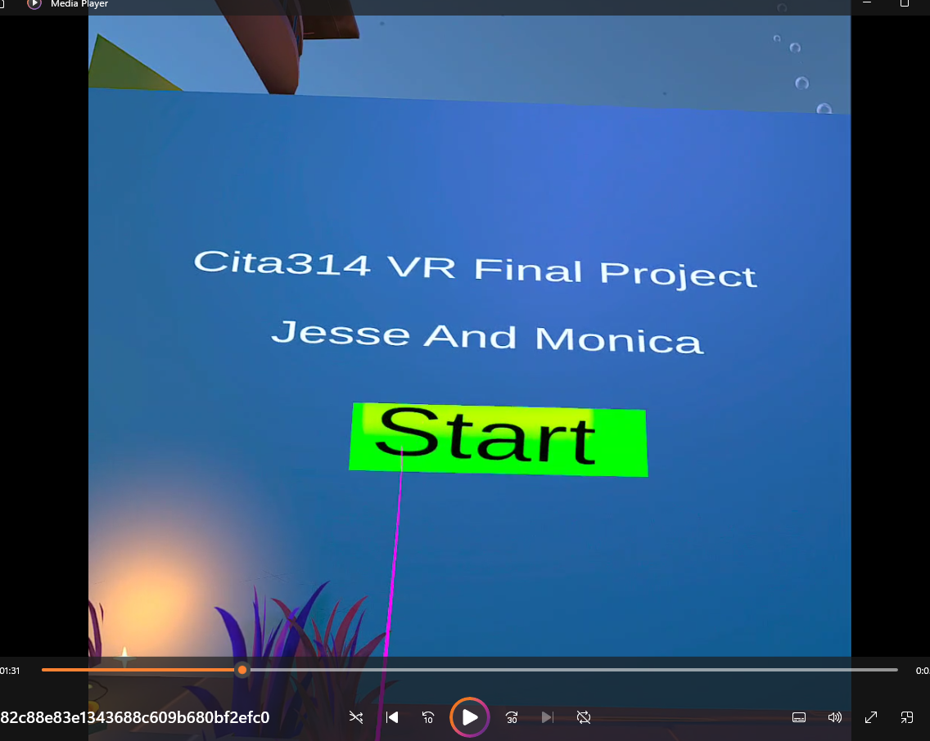

Slide 4
VR Setup Challenges
Issues with VR headsets and button mappings:
The start game button worked only through XR device simulator, not with VR controllers.
Had difficulty getting button inputs to work in VR, causing delays in starting the game.

Slide 5
Controller System Issues
Template issues:
Pre-existing template was difficult to modify for VR.
Ray caster issues, preventing button interactions.
Controller mappings complicated integration with the VR system, leading to difficulties.

Slide 6
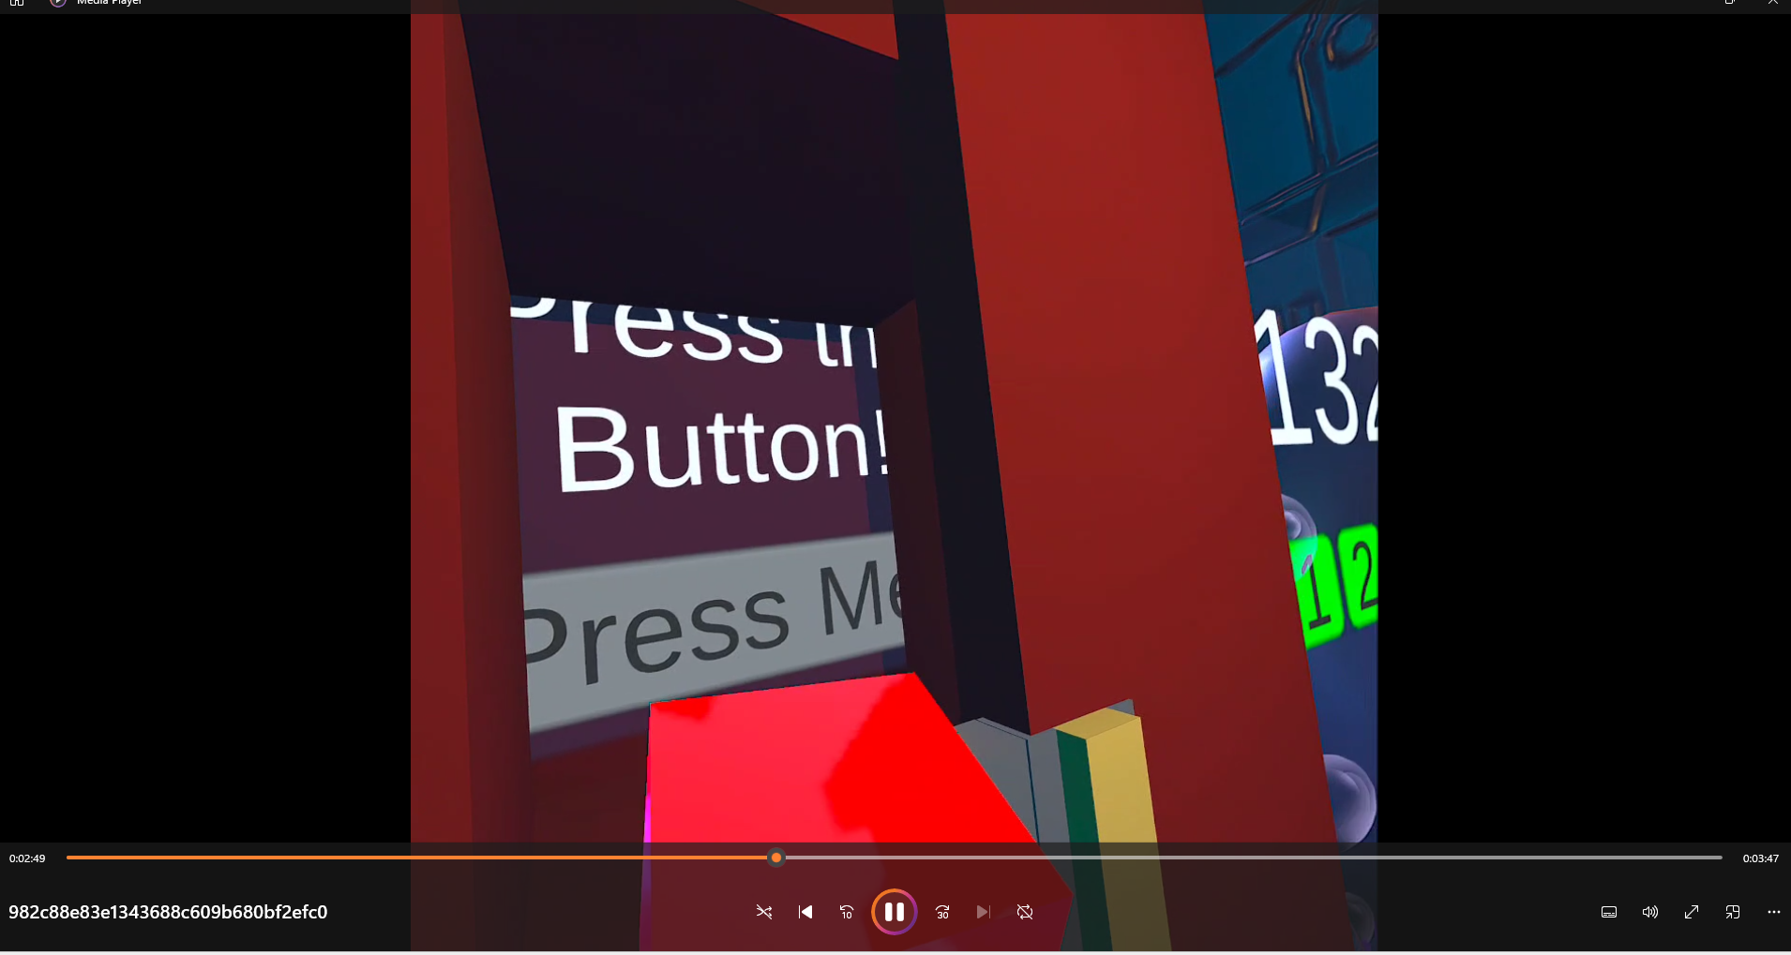

Slide 7
Wall-Breaking Game Issues
Struggles with VR integration for wall-breaking feature:
Wall wouldn’t burst as expected due to issues with the VR system.
Partner (Jesse) encountered difficulties getting wall-breaking mechanics to work.
Scripts and VR interactions did not align properly, hindering implementation.

Slide 8
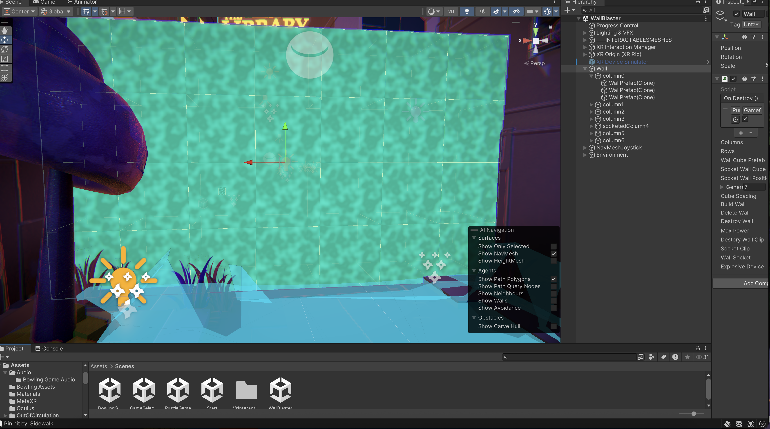

Slide 9
Bowling Game Issues
Frustrations with the bowling game setup:
VR system was not functioning correctly with the bowling game.
Changes to the original controller system made the integration with VR difficult.
Debugging the VR system became challenging, preventing smooth gameplay.

Slide 10
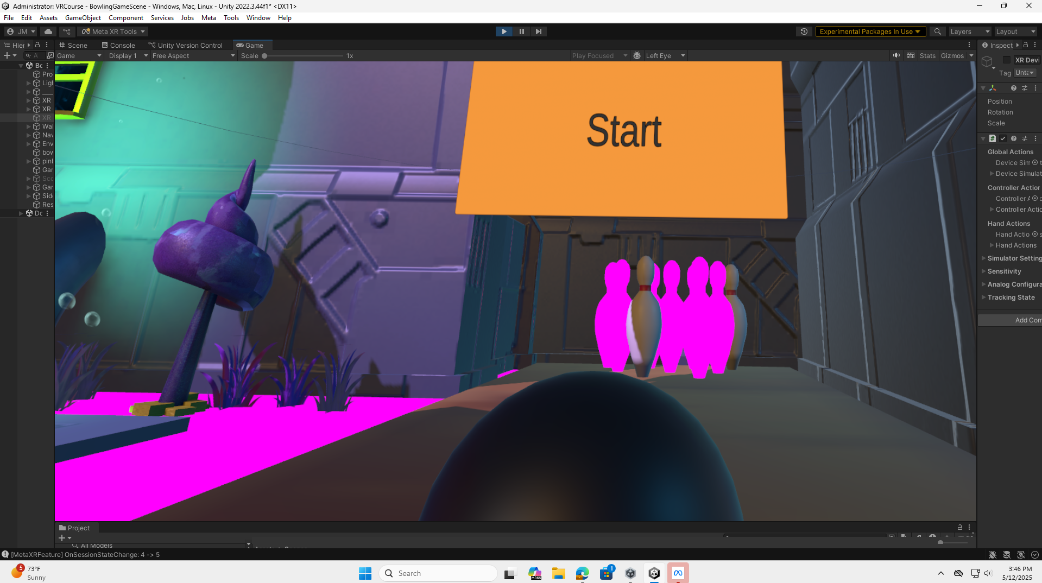

Slide 11
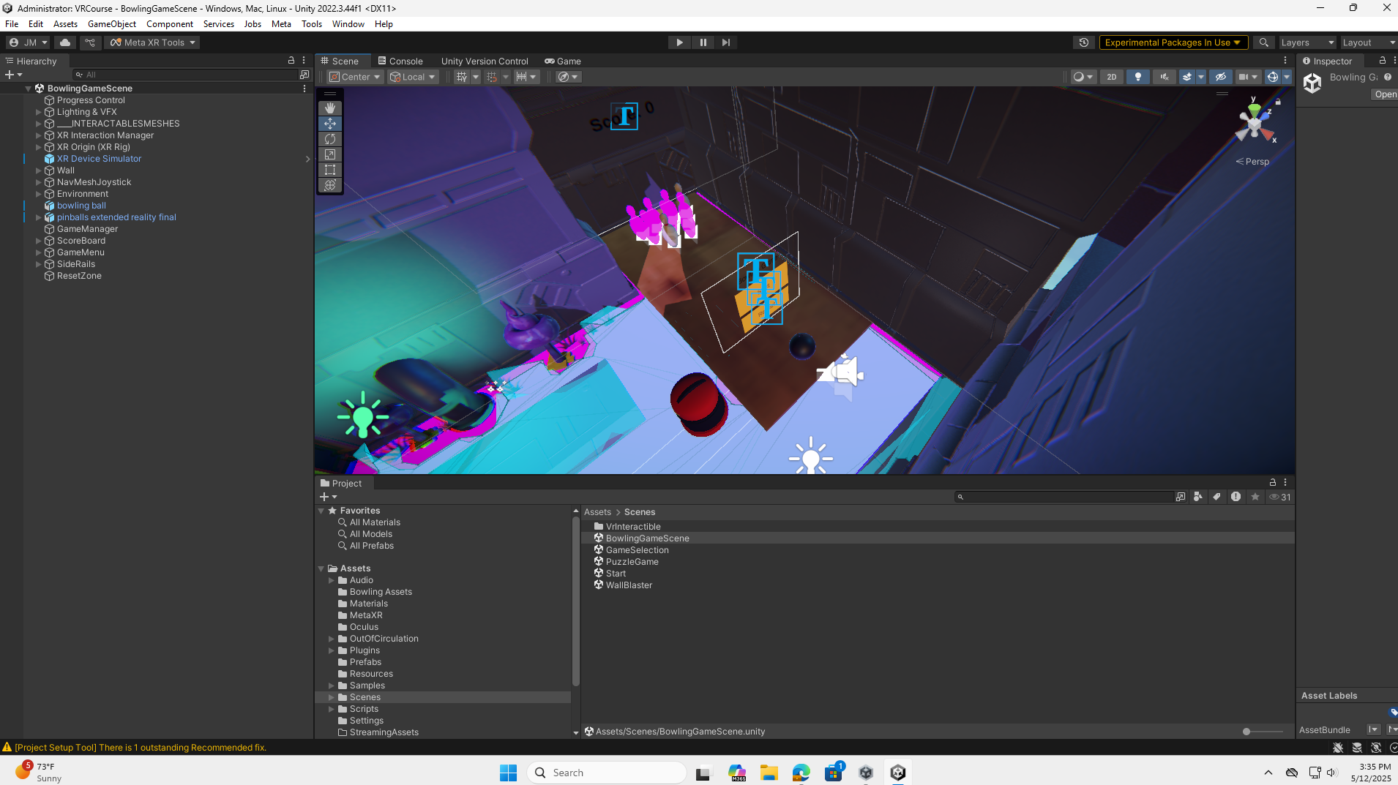

Slide 12
Conclusion
Despite efforts to integrate VR controls, we faced numerous challenges.
The complexity of the pre-configured template and issues with button mapping led to delays.
Further testing and revisions would be required to fully integrate VR with the bowling and wall-breaking games.

